Slide 1
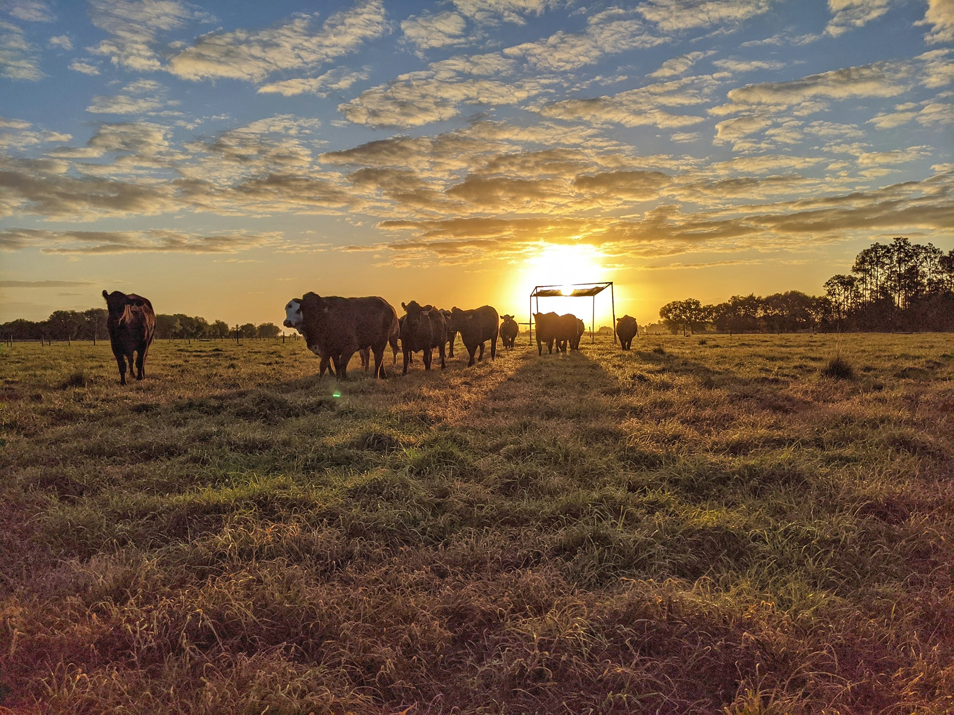
Nutrition & Management of beef females
2023 Ona Field Day
Philipe Moriel - Associate Professor Range Cattle Research & Education Center - University of Florida, Ona, FL

Slide 2
Current main topics focused by our nutrition group
Heat mitigation to optimize cow-calf performance
- Gestational heat stress
- Shifting heifer nutrition to cope with heat stress
Fetal programming for beef females in Florida
– Precalving supplementation of protein and energy

Slide 3
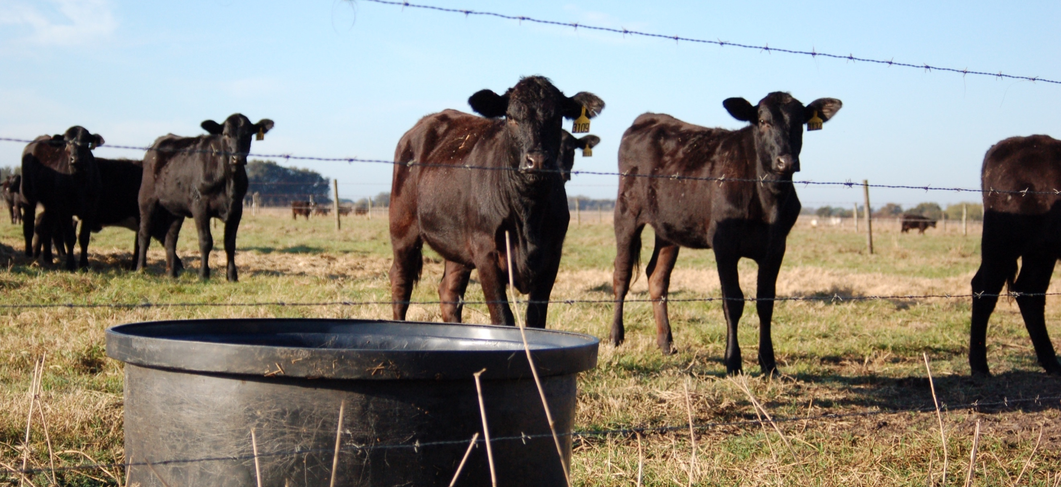
Gestational heat stress

Slide 4
Gestational heat stress – Dairy Cattle
Reduced fetal growth and birth weight by 9 lb (Tao et al., 2019)
Reduced weaning weights by 18 lb (Tao et al., 2019)
Remained after 1 year of age (Monteiro et al., 2016ab)
Reduced calf postnatal body weight, passive immunity
Reduced apparent efficiency of IgG absorption (Tao et al., 2012b)
Reduced cellular immunity and proliferation rate of peripheral blood mononuclear (Tao et al., 2012a)
Suggestive of under­developed immune organs due to maternal in utero heat stress
Reduced milk production of dairy heifers by 8 lb/day during first and second lactations (Laporta et al., 2018)
Transgenerational effects reducing milk yield of the dam’s granddaughters (Laporta et al., 2020)

Slide 5
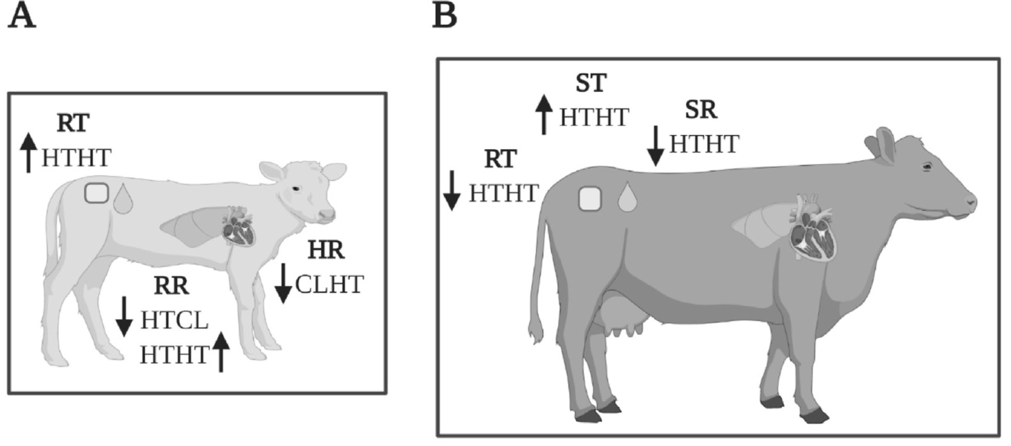
Gestational heat stress – Dairy Cattle
(A, Dado-Senn et al., 2020a)
(B, Ahmed et al., 2017)
Heat stress during late gestation decreased heat tolerance immediately after birth, but increased heat tolerance at maturity by increasing capacity to dissipate heat and maintain core body temperature.
Calves exposed to in-utero heat stress then postnatal heat stress (HTHT) had a higher rectal temperature (RT) and respiration rate (RR). Calves exposed to in-utero cooling then heat stressed postnatally had the lowest heart rate (HR).
Heifers exposed to in-utero heat stress and then heat-stressed during lactation had a lower RT and sweating rate (SR) but a higher skin temperature (ST).

Slide 6
Impacts of pre- and postpartum heat stress abatement on physiology and performance of grazing Bos indicus-influenced cow-calf pairs
Vinicius de Souza Izquierdo Range Cattle Research & Education Center
University of Florida, Ona, FL
February 21, 2023

Slide 7
Hypothesis & Objectives
Hypothesis: The use of heat abatement strategies during late gestation and early postpartum will reduce body temperature but increase body condition score at calving and enhance postnatal growth and immune function of their progeny.
Objectives: To evaluate the impacts of heat abatement during pre- and postpartum on prepartum body temperature, body condition score change, physiological measurements of heat-stressed Bos indicus-influenced beef heifers, and postnatal growth and immunocompetence of their progeny.

Slide 8
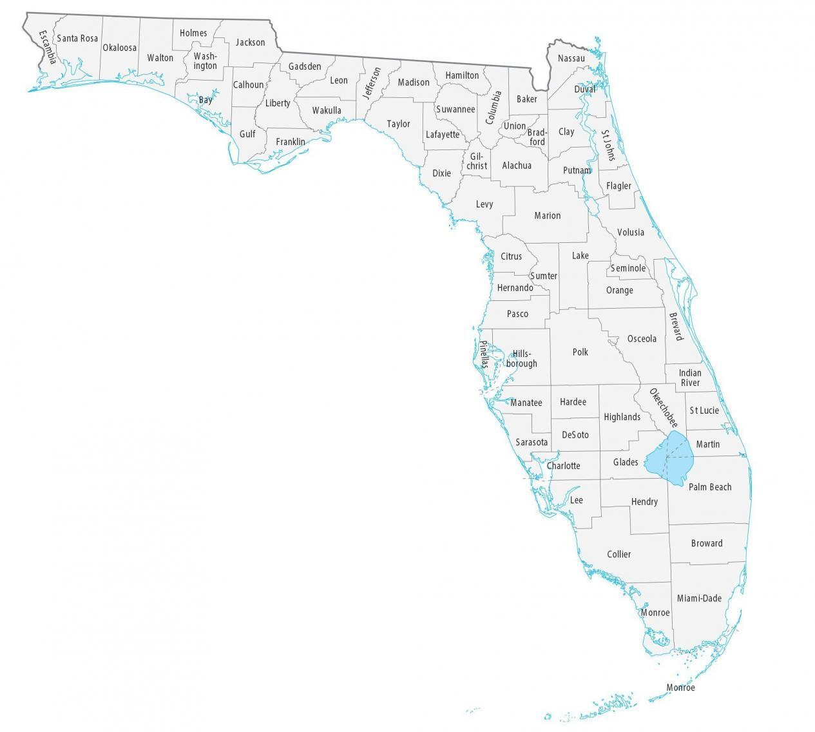
Experimental Design
Range Cattle Research and Education Center
July 2021 to March 2022
64 pregnant Brangus heifers (21 months)
BW: 454 ± 37 kg
BCS: 6.3 ± 0.28
1 of 16 bahiagrass pastures (4 heifers/pasture)
Treatments (8 pastures/treatment)

Slide 9
Experimental Design
Maternal Treatment
July
day 0
August
day 58
November day 133
January day 203
CALVING SEASON
Early wean
ACCESS TO SHADE (3.7m²/Heifer)
ACCESS TO SHADE (3.7m²/Heifer)
SHADE
NO ACCESS TO SHADE
ACCESS TO SHADE (3.7m²/Heifer)
NO SHADE

Slide 10
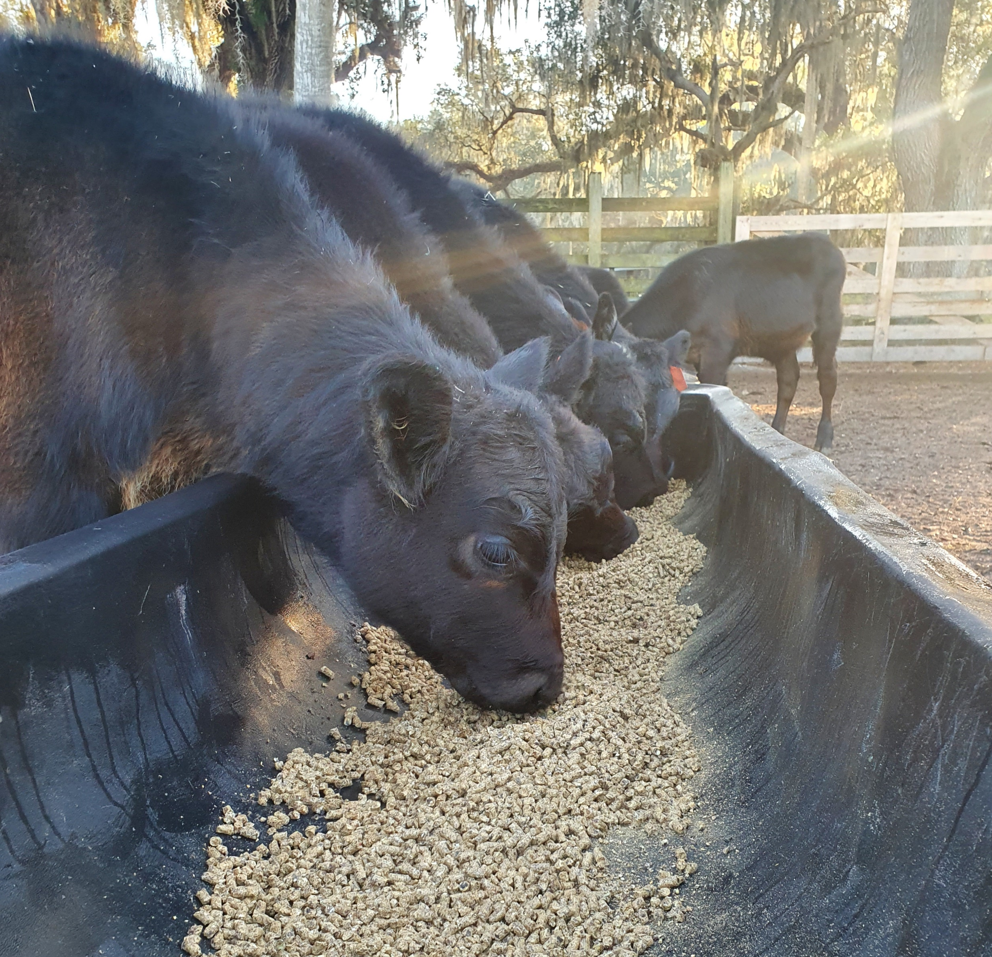
Experimental Design
Offspring Management
January
day 209
March day 268
52 Calves (119 ± 19 d of age)
1 of 16 drylot pens (3 to 4 calves/pen)
Same distribution of the maternal treatment
Soybean hulls-based diet (3.25% DM of BW)
CP: 21.0%
NDT: 71.5%

Slide 11
Maternal Results

Slide 12
THI
Severe heat stress
>77
THI = (1.8 × ET + 32) – [(0.55-0.0055 × RH) × (1.8 × ET – 26)]
Dikmen and Hansen, 2009
Thermoneutral
<70
End of treatments
Last Third of Gestation
Calving Season
No treatments
Drylot Phase
Jul
Aug
Sep
Oct
Nov
Dec
Jan
Feb
Mar

Slide 13
Cumulative Heat Load day 35-41 (Aug 4th to 10th)
Shade = Access to shade from day 0 to 133
No Shade = No access to shade from day 0 to 133
THI value | THI Level | Heat Load Score
THI < 68 | Cool | -1
68 < THI ≤ 72 | Neutral | 0
72 < THI ≤ 76 | Low | 1
76 < THI ≤ 79 | Moderate | 2
79 < THI ≤ 83 | High | 3
THI > 83 | Critical | 4
Mateescu et al., 2020
34 Cumulative HL

Slide 14
Intravaginal Temperature and Thermal Humidity Index day 35-41 (Aug 4th to 10th)
Shade = Access to shade from day 0 to 133
No Shade = No access to shade from day 0 to 133
Shade × Hour of the day
P < 0.0001
+P ≤ 0.05

Slide 15
Respiration Rate
Shade = Access to shade from day 0 to 133
No Shade = No access to shade from day 0 to 133
 | Shade access |  |  |  | P-value
 | NSH | SH | SEM | P | Shade x day
Respiration rate, breaths per minute
day 20 (July 20th) | 104 | 64 | 3.7 | <0.0001 | <0.001
day 40 (Aug 9th) | 107 | 78 | 3.7 | <0.0001
day 56 (Aug 25th) | 101 | 72 | 3.7 | <0.0001
day 76 (Sep 14th) | 89 | 65 | 3.7 | 0.0001
day 96 (Oct 4th) | 67 | 46 | 3.7 | 0.0007
day 126 (Nov 3rd) | 49 | 43 | 3.7 | 0.30

Slide 16
Intravaginal Temperature and Thermal Humidity Index day 126-132 (Nov 3rd to 9th)
Shade = Access to shade from day 0 to 133
No Shade = No access to shade from day 0 to 133
Shade × Hour of the day
P = 0.99

Slide 17
Cumulative Heat Load day 126-132 (Nov 3rd to 9th)
Shade = Access to shade from day 0 to 133
No Shade = No access to shade from day 0 to 133
THI value | THI Level | Heat Load Score
THI < 68 | Cool | -1
68 < THI ≤ 72 | Neutral | 0
72 < THI ≤ 76 | Low | 1
76 < THI ≤ 79 | Moderate | 2
79 < THI ≤ 83 | High | 3
THI > 83 | Critical | 4
Mateescu et al., 2020

Slide 18
Maternal BW and BCS
Shade × Day
P < 0.0001
P = 0.98
P = 0.01
P = 0.93
P < 0.0001
P = 0.62
P = 0.001
Jul Aug Sep Nov Jan Apr
Shade × Day
P = 0.08
P = 0.38
P = 0.61
P = 0.99
P = 0.67
P = 0.009
P = 0.43
Jul Aug Sep Nov Jan Apr
Near calving
After calving
Start of
breeding season
End of
breeding season

Slide 19
Maternal Plasma Analyses
Shade = Access to shade from day 0 to 133
No Shade = No access to shade from day 0 to 133
P = 0.26
Shade × Day
P = 0.03
P = 0.10
P = 0.03
P = 0.05
Jul Aug Sep Nov
Shade × Day
P = 0.01
P = 0.85
P = 0.07
P = 0.02
P = 0.79
Jul Aug Sep Nov

Slide 20
Offspring Results

Slide 21
Offspring Performance
Shade × Day
P = 0.03
a
b
^{ab}P ≤ 0.05
 | Treatment |  |  | P-value
 | NSH | SH | SEM | Shade
Calf birth BW, kg | 28 | 30 | 0.8 | 0.05
Calves born alive, % of total | 97 | 100 | 2.6 | 0.40
Calf ADG, kg/day
Birth to early-weaning (day 203) | 0.72 | 0.73 | 0.034 | 0.80
Drylot entry to exit (day 209-268) | 1.18 | 1.09 | 0.036 | 0.07
Birth to drylot exit (day 268) | 0.84 | 0.81 | 0.026 | 0.39

Slide 22
Offspring Plasma Analyses
 | Maternal treatment |  |  | P-value
Item | NSH | SH | SEM | Shade | Shade × day
Plasma cortisol, ug/dL | 2.43 | 2.42 | 0.149 | 0.93 | 0.15
Plasma Hp, mg/mL | 0.405 | 0.468 | 0.0235 | 0.06 | 0.80
 | Maternal treatment |  |  |  | P-value
Item | NSH | SH | SEM | P | Shade | Shade × day
BRSV
Seroconversion, % of total
Day 222 | 76.9 | 50.0 | 8.57 | 0.02 | 0.23 | 0.01
Day 236 | 69.2 | 50.0 | 8.57 | 0.10
Day 268 | 80.2 | 96.2 | 8.57 | 0.19
Serum titers, log2
Day 222 | 2.00 | 1.31 | 0.285 | 0.08 | 0.26 | 0.09
Day 236 | 1.85 | 1.27 | 0.285 | 0.15
Day 268 | 2.69 | 3.00 | 0.291 | 0.44
Notes:
Preciso do P calf BW d 209 e 268

Slide 23
Offspring Plasma Analyses
 | Maternal treatment |  |  | P-value
 | NSH | SH | SEM | Shade | Shade × day
BVDV-1
Seroconversion, % of total
Day 268 | 76.9 | 76.9 | 8.88 | 1.00 | 0.44
Serum titers, log2
Day 268 | 3.84 | 4.43 | 0.632 | 0.67 | 0.69
IBR
Seroconversion, % of total
Day 268 | 63.7 | 53.9 | 8.97 | 0.24 | 0.97
Serum titers, log2
Day 268 | 1.63 | 1.42 | 0.234 | 0.41 | 0.94
PI-3
Seroconversion, % of total
Day 268 | 100 | 96.2 | 3.86 | 0.47 | 0.82
Serum titers, log2
Day 268 | 8.76 | 8.19 | 0.513 | 0.57 | 0.83
Notes:
Preciso do P calf BW d 209 e 268

Slide 24
Conclusions
Access to shade during pre- and postpartum alleviated the effects of heat stress by reducing intravaginal temperature, decreasing respiration rates and modifying the behavior of pregnant heifers
Heat abatement increased heifer body condition score and plasma IGF-1 during late gestation and increased calf birth body weight, but reduced calf post-weaning growth and had minor changes to calf humoral immune function
Notes:
Preciso do P calf BW d 209 e 268

Slide 25
On-going studies
Mitigating Heat Stress in grazing Bos indicus-Influenced Beef Cattle in Tropical/Subtropical Environments
USDA – Animal Nutrition, Growth, and Lactation
$640,000
PI = Philipe Moriel
Co-PIs = Joe Vendramini, Nicolas DiLorenzo, Raluca Mateescu, Joao Bittar, Mario Binelli, Jimena Laporta Francisco Peñagaricano
Initiated in August 2022
To be completed in 2026

Slide 26
USDA Study – Combining heat stress mitigation strategies during pre- and postnatal phases: Impacts on cow and heifer offspring performance
320 Brangus, pregnant mature beef cows on bahiagrass pastures
Treatments (2 x 2 factorial design): Applied during gestation and then heifer development
No heat abatement (CONTROL) = No access to artificial shade
Heat abatement strategy (HAST) = Unlimited access to artificial shade (40 sq ft per animal)

Slide 27
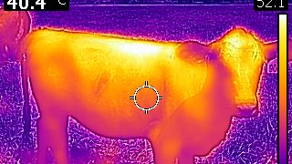
Shifting heifer nutrition to cope with heat stress

Slide 28
Not pubertal vs. pubertal Brangus heifers at start of breeding season
 | Puberty status at the start of the breeding season
Pregnant heifers, % of total | Prepubertal | Pubertal | SEM | P-value
Year 1 | 33.9 | 78.2 | 12.2 | 0.001
Year 2 | 39.4 | 85.0 | 6.1 | 0.005
Average | 36.2 | 81.6 | 10.3 | <0.0001
Moriel et al. (2020) J. Anim. Sci. https://doi.org/10.1093/jas/skaa236
*P ≤ 0.05
 | Puberty status at the start of the breeding season
Item | Prepubertal | Pubertal | SEM | P
Pregnancy % | 55.4 | 87.4 | 11.7 | <0.001
Calving % | 51.0 | 72.2 | 11.6 | 0.009
*
*
*
*
*
*
*
Moriel et al. (2017) J. Anim. Sci. 95:3523–3531 https://doi.org/10.2527/jas.2017.1666

Slide 29
Thermal humidity-index (THI) - Ona 2019
Severe heat stress
>77
Heat stress
74 to 77
Thermoneutral
<70
NRC (1971): THI = (1.8 × T_{environ.} + 32) – [(0.55-0.0055 × Relative Humidity) × (1.8 × T_{environ.} – 26)].

Slide 30
Slide from Drs. Silva & DiLorenzo – Marianna/NFREC

Slide 31
Constant vs. stair-step supplementation
CONSTANT
Body weight
STAIR-STEP
Day of the study
Less supplement intake
Less heat increment?
Greater supplement intake
Compensatory growth
Higher THI
Lower THI

Slide 32
Boosting reproduction without increasing feed costs of beef heifers in Florida Funded by Florida Cattlemen Enhancement Board - 2019/2020
Sep. 2019 to June 2020 (Yr 1) and Sep. 2020 to June 2021 (Yr 2)
64 Brangus heifers per year assigned to 16 bahiagrass pastures
Treatments assigned to pastures (6 pastures/treatment/year):
CONTROL = concentrate supplementation at 1.50% of body weight from September until the start of the estrous synchronization (November; day 0 to 100)
STAIRSTEP = concentrate supplementation at 1.05% of body weight from Aug. to Sep. (day 0 to 49) + 1.95% of body weight until the start of the estrous synchr. (day 50 to 100).
After day 100, all heifers were managed similarly:
AI from day 113 to 115; Timed-AI on day 115
Bulls from day 121-211
Concentrate supp. at 1.50% of BW until day 211
Moriel et al. (2022). J. Anim. Sci. In press

Slide 33
Intravaginal Temperature and Thermal Humidity Index d 25-31 (Sep 7th to 13th)
 | Supplementation strategy
Item | CON | SST | SEM | P-value
ADG, lb/day
day 0 to 49 | 1.24 | 1.17 | 0.056 | 0.35
day 49 to 100
day 0 to 100
CON = Suppl. 1.50% of BW d 0-100
SST = Suppl. 1.05% of BW d 0-49
Suppl. 1.95% of BW d 50-100
Moriel et al. (2022). J. Anim. Sci. In press

Slide 34
Intravaginal Temperature and Thermal Humidity Index d 85-91 (Nov 6th to 12th)
 | Supplementation strategy
Item | CON | SST | SEM | P-value
ADG, lb/day
day 0 to 49 | 1.24 | 1.17 | 0.056 | 0.35
day 49 to 100 | 1.22 | 1.61 | 0.061 | <0.001
day 0 to 100 | 1.23 | 1.39 | 0.043 | 0.01
CON = Suppl. 1.50% of BW d 0-100
SST = Suppl. 1.05% of BW d 0-49
Suppl. 1.95% of BW d 50-100
Moriel et al. (2022). J. Anim. Sci. In press

Slide 35
Growth performance and Supplement DM offered d 0-100 (Aug 13th to Nov 21th)
CON = Suppl. 1.50% of BW d 0-100
SST = Suppl. 1.05% of BW d 0-49
Suppl. 1.95% of BW d 50-100
 | Supplementation strategy
Item | CON | SST | SEM | P-value
ADG, lb/day
day 0 to 49 (Aug to Sep) | 1.24 | 1.17 | 0.056 | 0.35
day 49 to 100 (Sep to Nov) | 1.22 | 1.61 | 0.061 | <0.001
day 0 to 100 (Aug to Nov) | 1.23 | 1.39 | 0.043 | 0.01
Total supplement DM offered, lb/heifer
day 0 to 100 (Aug to Nov) | 925 | 933 | 13.5 | 0.66
P = 0.01
P = 0.91
P = 0.49
Supp. × day
P = 0.002
Moriel et al. (2022). J. Anim. Sci. In press

Slide 36
Reproductive performance d 100-211 (Nov 21th to Mar 11th)
CON = Suppl. 1.50% of BW d 0-100
SST = Suppl. 1.05% of BW d 0-49
Suppl. 1.95% of BW d 50-100
 | Supplementation strategy
Item | CON | SST | SEM | P-value
Pubertal heifers, % of total
day 91 | 69.2 | 66.1 | 4.82 | 0.67
day 101 | 73.5 | 75.7 | 4.82 | 0.76
Reproductive tract score, day 101 | 4.48 | 4.54 | 0.119 | 0.71
Heifers in estrus, % of total
day 101 to 105 | 28.3 | 28.9 | 5.78 | 0.94
day 113 to 115 | 64.9 | 63.9 | 5.78 | 0.90
Pregnant heifers, % of total
AI (day 154; Dec) | 39.1 | 47.1 | 6.11 | 0.36
Final (day 275; Apr) | 84.4 | 94.8 | 3.62 | 0.04
Stair-step strategy reduced vaginal temperature during heat stress and improved growth and reproductive performance of heifers, without increasing feed costs
Moriel et al. (2022). J. Anim. Sci. In press

Slide 37
Precalving nutrition

Slide 38
Impacts of maternal precalving nutrition (No Supp. vs. Supp.) on body condition score (BCS) and reproduction of cows and growth and immune response of their calves (studies¹ at the Range Cattle REC; Ona, FL)
 | Study 1 |  | Study 2 |  | Study 3 |  | Study 4 |  | Study 5
Item | No Supp. | Supp. | No Supp. | Supp. | No Supp. | Supp. | No Supp. | Supp. | No Supp. | Supp.
Initial BCS | 5.7 | 5.7 | 5.5 | 5.5 | 5.3 | 5.4 | 5.0 | 5.0 | 5.5 | 5.5
Calving BCS | 5.8ª | 6.1^{b} | 5.0ª | 5.4^{b} | 5.2ª | 5.8^{b} | 4.7ª | 5.6^{b} | 5.0ª | 5.5^{b}
Pregnancy, % | 91.7 | 94.4 | 78.5 | 75.8 | 96.2 | 96.3 | 82ª | 95^{b} | 93.3 | 86.8
Calf weaning weight, lb | 275ª | 295^{b} | 579ª | 597^{b} | 561ª | 591^{b} | 535ª | 563^{b} | 557ª | 581^{b}
Response to vaccination, % | 56.1ª | 81.5^{b} | - | - | 21ª | 54^{b} | - | - | - | -
^{ab} Means without a common superscript differed (P < 0.05).
¹ Study 1 = 0 or 2.2 lb/day of molasses + urea for 57 days before calving (Moriel et al., 2020). doi:10.1093/jas/skaa123
Study 2 = 0 or 2.2 lb/day of molasses + urea for 47 days before calving (Palmer et al., 2020). doi:10.1016/j.livsci.2020.104176
Study 3 = 0 or 2.2 lb/day of dried distillers grains for 90 days before calving (Palmer et al., 2022). doi:10.1093/jas/skac022
Study 4 = 0 or 2.2 lb/day dried distillers grains for 70 days before calving (Izquierdo et al., 2022). In review
Study 5 = 0 or 2.2 lb/day dried distillers grains for 77 days before calving (Vedovatto et al., 2022). In review
In all studies, cows and their calves were managed similarly from calving until calf weaning. Calves were early weaned at 2 to 3 months of age in Study 1 and normally weaned at 8 to 9 months of age in Studies 2, 3, 4, and 5.

Slide 39
Thank you
Philipe Moriel
Associate Professor pmoriel@ufl.edu
Julie Warren
Biological Scientist
Vinicius Izquierdo
Ph.D. Student
Giovanna Santos
Intern Student

